Slide 1




Statistics

Slide 2
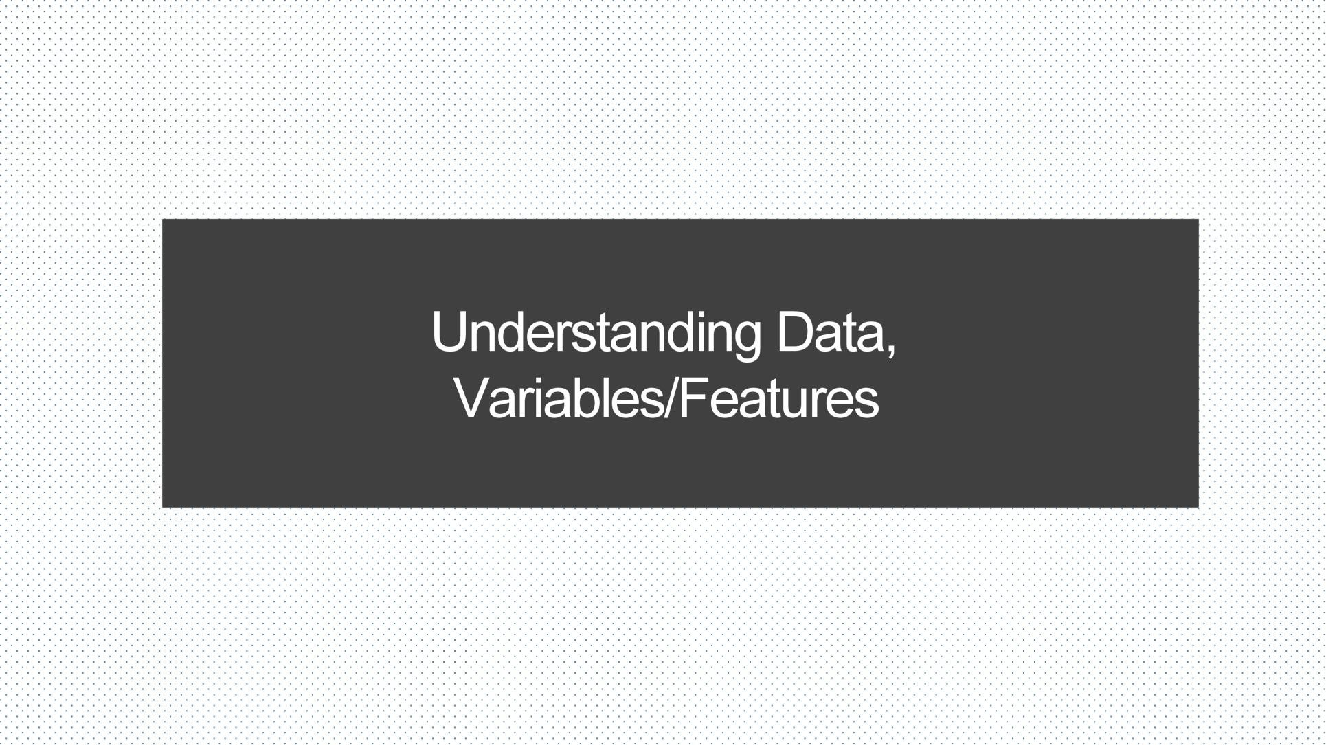

Slide 3




Variable Types:
Quantitative variables
are amounts or counts variables
for example: age, number of children,income
Categorical/ Qualitative variables
represent groupings variables that can be grouped into distinct categories for example: type of pet, agreement rating, and brand of shoes
Variable
Quantitative
Qualitative

Slide 4
Quantitative Variable
Continuous variables :
contain measurements with decimal precision,
for example : the height or weight of a person.
Discrete variables :
contain counts that must be whole integer values,
For example : the number of members in a person’s family, or the number of goals a basketball team scored in a game

Slide 5



Quantitative Variable
Quantitative
Discrete
Numbered values that can only
take certain integer values
Continuous
Numbered values that can be
number within a particular range.
0 1 2 3 4 5
0 0.5 1 1.5 2 2.5 3

Slide 6
Qualitative Variable
Ordinal variables :
variables which are groups that contain an inherent ranking,
For example : ratings of plays or responses to a survey question with a point scale [ on a scale from 1-7, how happy are you right now?]
Nominal variables :
variables are made of categories without an inherent order,
For example : species of ants, or people’s hair color.

Slide 7
Qualitative Variable
Qualitative
Ordinal
Categories with order ranking
Nominal
Categories with NO order ranking Example
Gender(male/female)
Example
Size(S,M,L,XL,2XL,…)

Slide 8
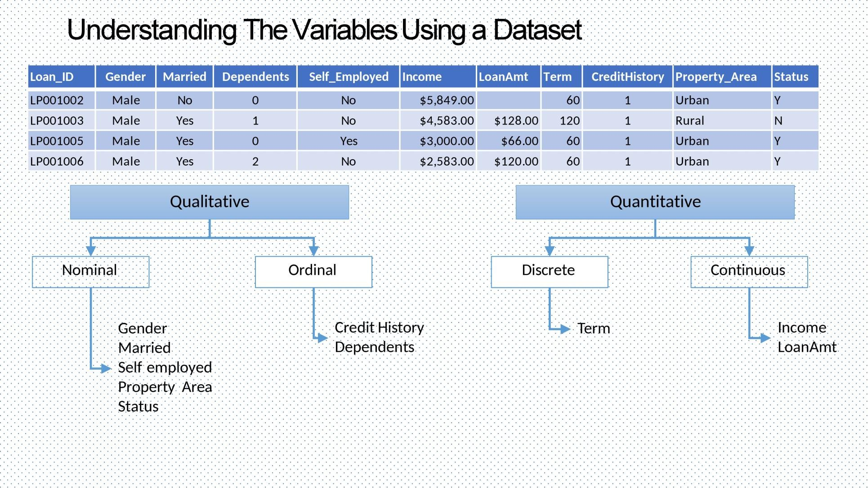

Slide 9
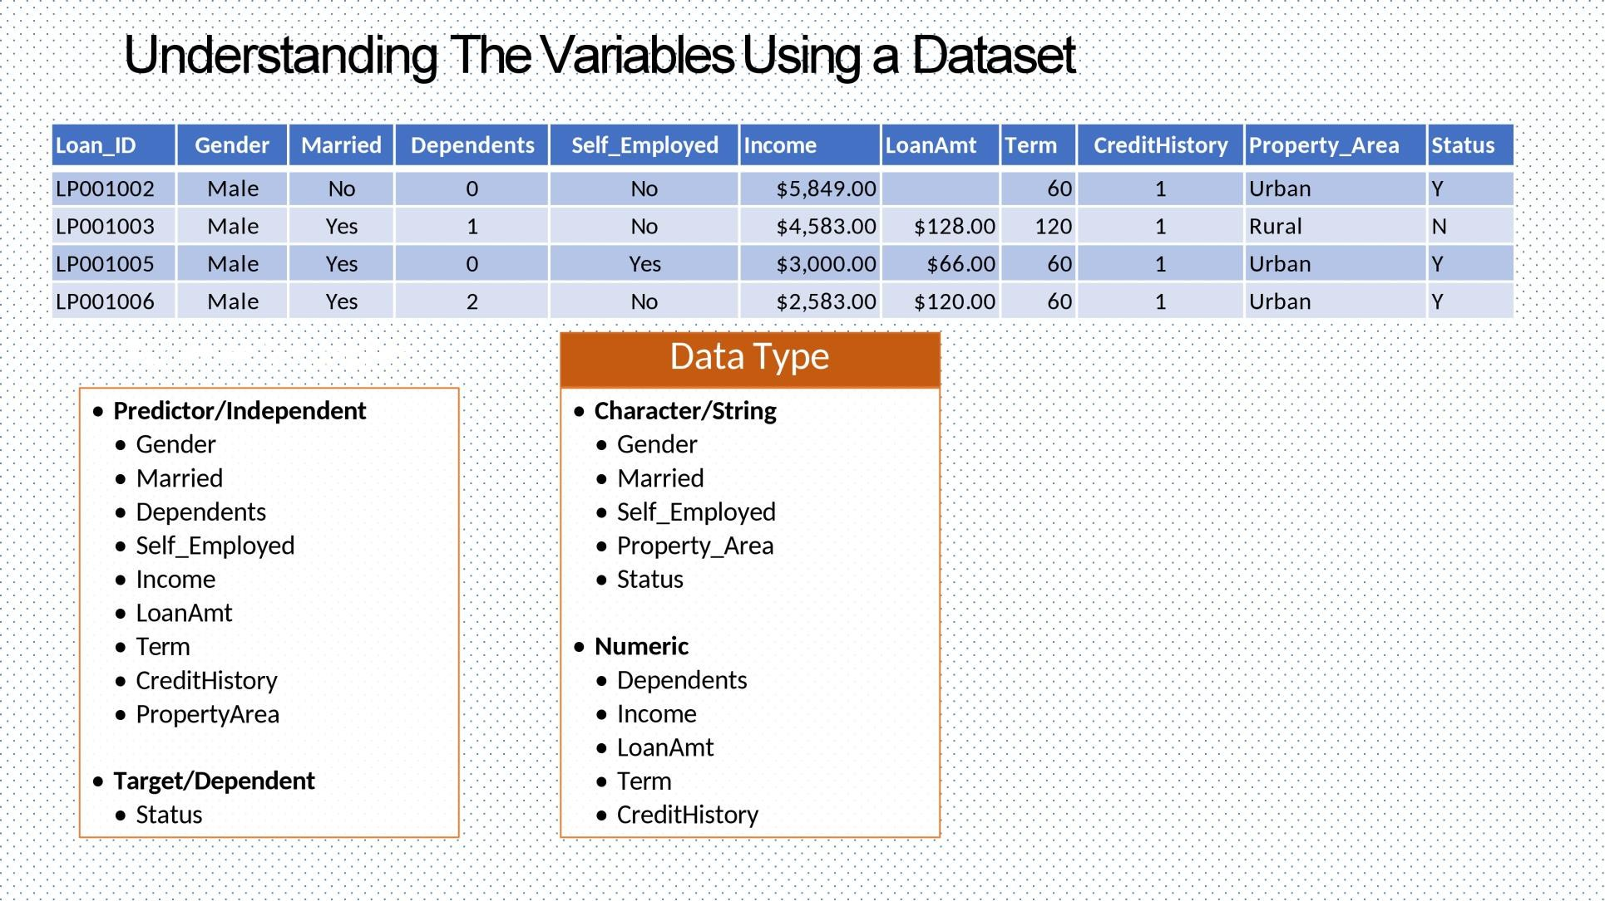

Slide 10


1. The tree is tall, The tree is 15M
⬡ A. Qualitative, Quantitative
⬡ B. Quantitative, Qualitative
⬡ C. Qualitative, Qualitative
⬡ D. Quantitative, Quantitative
11

Slide 11
What Is Statistics?
Statistics is a branch of applied mathematics that involves the collection, description, analysis, and inference of conclusions from quantitative data.
Two types of statistical methods are used in analyzing data:
Descriptive statistics
inferential statistics.
12

Slide 12
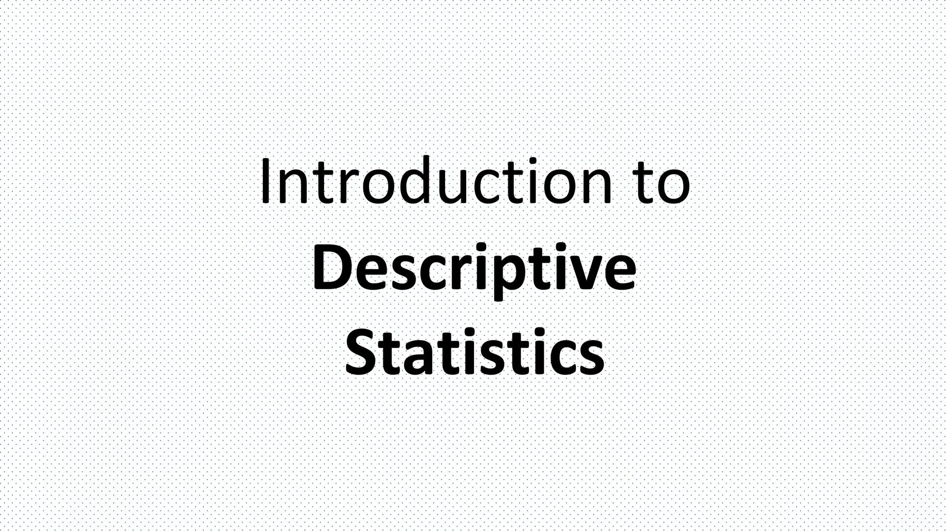

Slide 13
Descriptive statistics
is a way to describe, show or summarize data in a meaningful way,
allow us to make conclusions beyond the data we have analysed or reach conclusions regarding any hypotheses we might have made.
14

Slide 14
Types of descriptive statistics:
Measures of central tendency:
these are ways of describing the central position of a frequency
distribution for a group of data
such as mean, median, and mode.
Measures of Dispersion or Variation:
these are ways of summarizing a group of data by describing how spread out the scores are.
Such as range, Interquartile range,variance ,Percentile , Quartile and standard deviation.
15

Slide 15


Slide 16
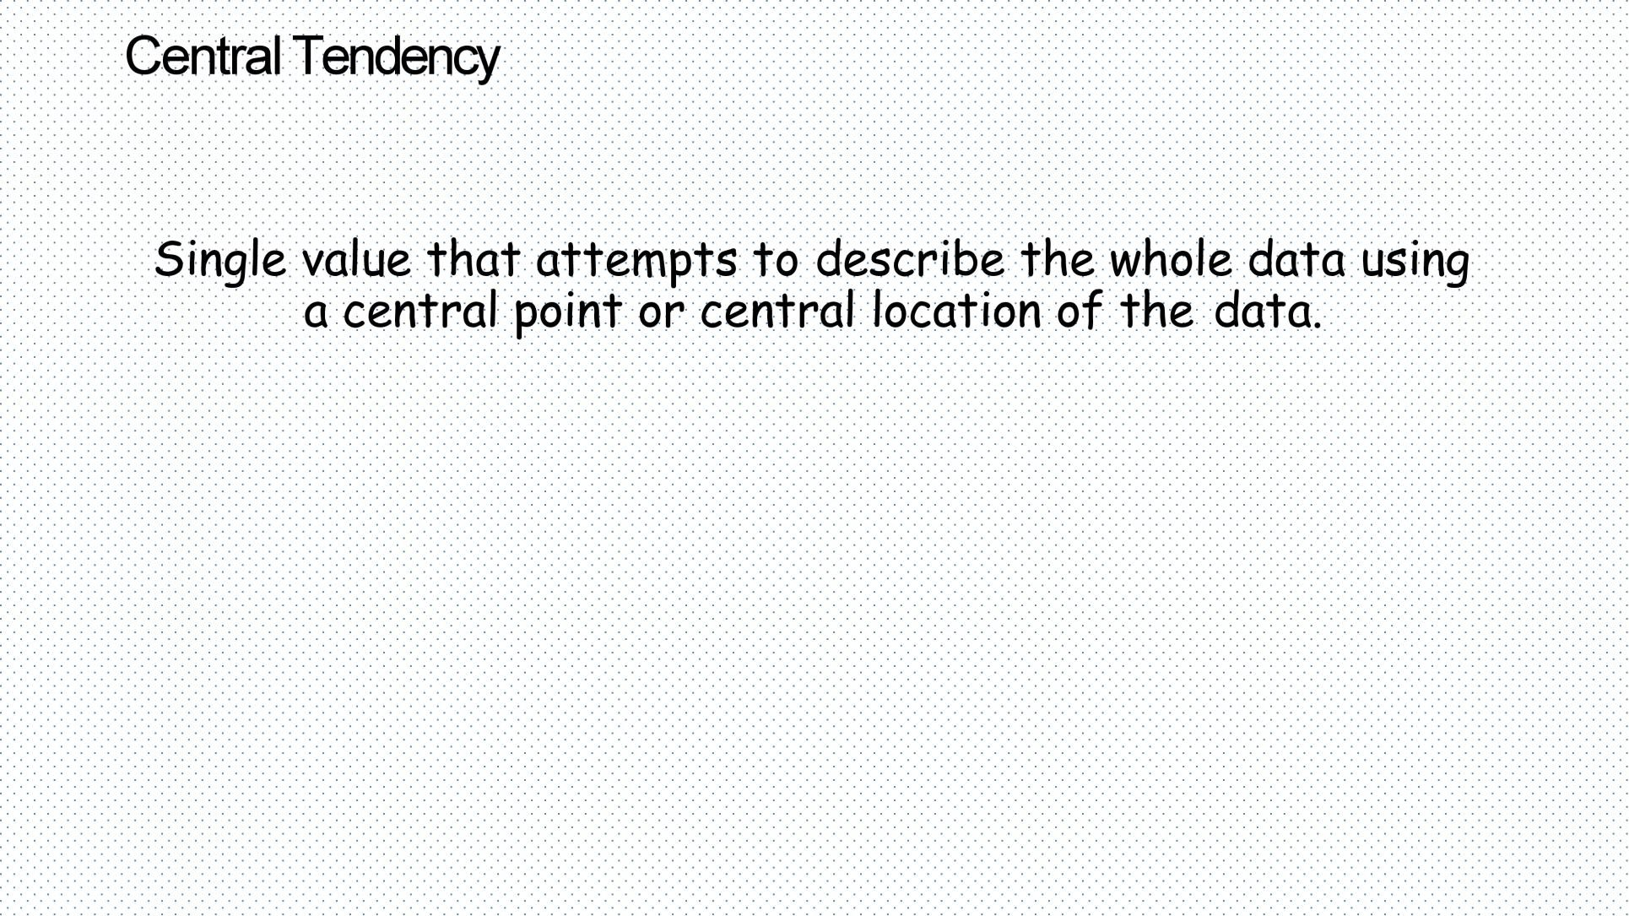

Slide 17
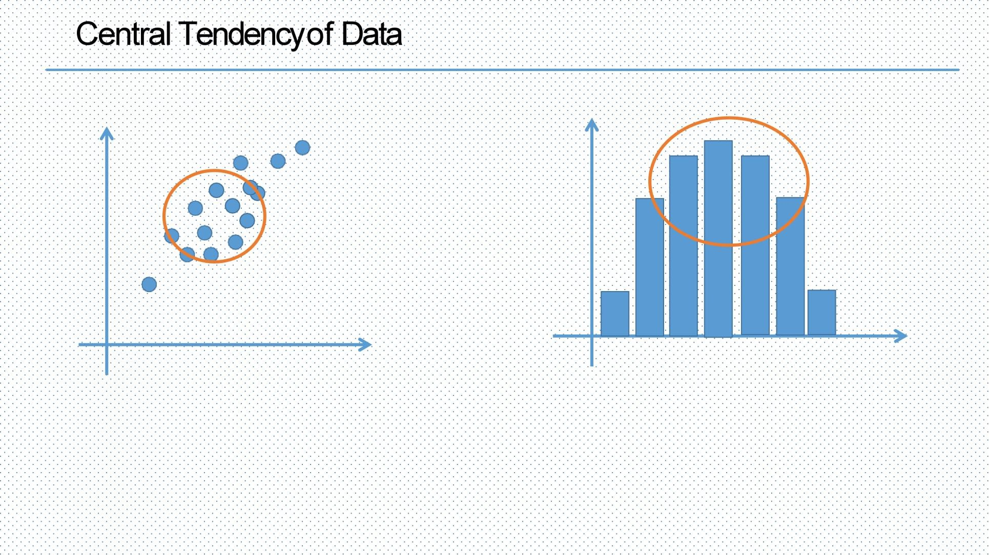

Slide 18
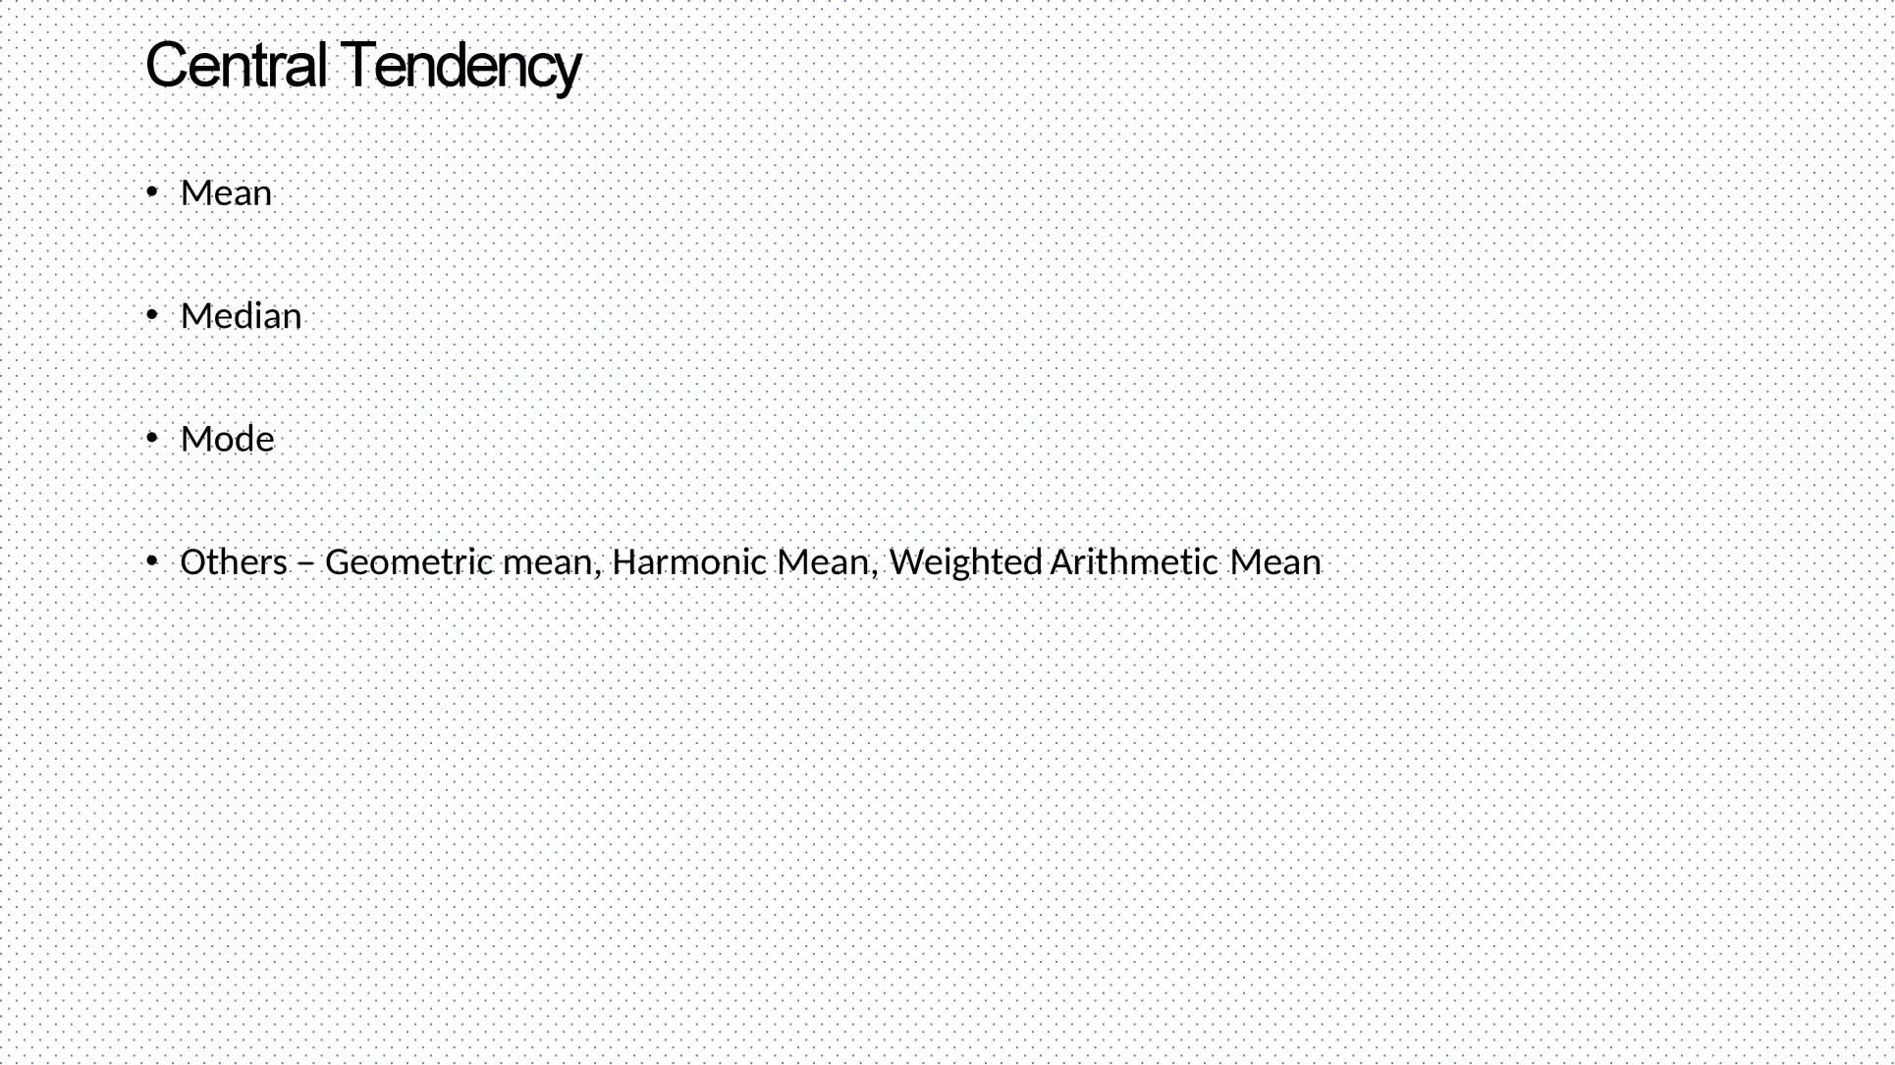

Slide 19
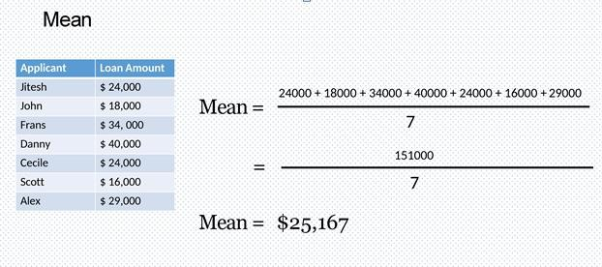
Mean:
The mean (average) : found by adding all numbers in the data set and then dividing by the number of values in the set.

Slide 20
⬡ Find the mean of these numbers:5,11,2,12,4,2
A.8 B.11
C.6
21

Slide 21
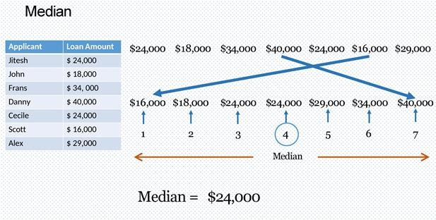
Median:
The median : the middle number in a sorted, ascending or descending, list of numbers (odd number of cases)

Slide 22




Median
If you have even number no cases (let’s think 6 cases). In this case there is no single middle value.Then how do we calculate median?
Well, we just take the average of the two middle values.
Median cases
Even
Odd
5,8,10,16,2,7,6,9
2,5,6,7,8,9,10,16
5,8,10,16,2,7,6
2,5,6,7,8,10,16
(7+8)/2=7.5 is the median
7 is the median

Slide 23

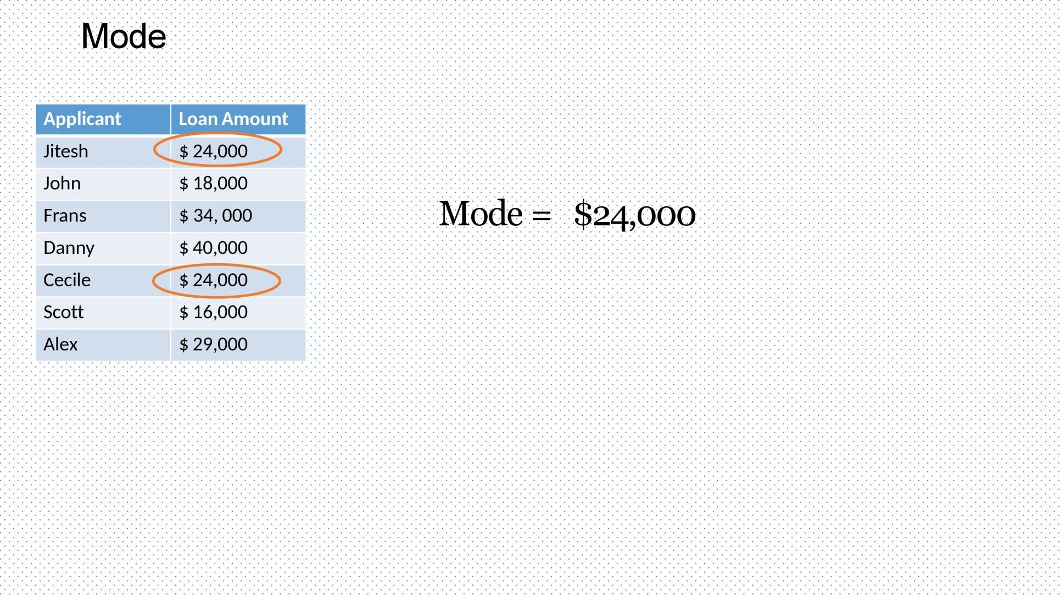



Mode:

Slide 24

Mode:
The Mode: it is the one or more values that occur most frequently
Mode cases
One Value
More Values
5,6,5,16,5,7,6,5
5 in the mode
5,8,5,8,10,5,8,7
5,8 are the mode

Slide 25
Sum of mode and median of the data 12, 15, 11, 13, 18, 11, 13, 12, 13
a. 26
b. 31
c. 36
d. 25

Slide 26
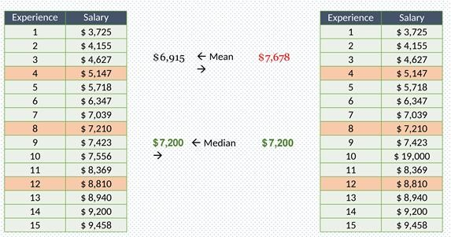
Effect Of Outliers In Descriptive Statistic:
An outlier is any unusually large or small observation.
Outliers can have a disproportionate effect on statistical results, such as the mean but doesn’t affect median or mode which can result in misleading impressions

Slide 27
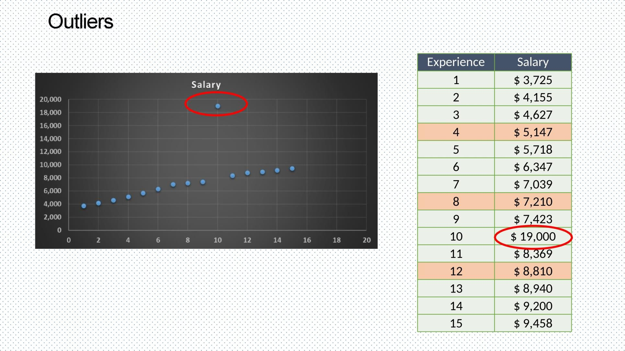
Effect Of Outliers In Descriptive Statistic:

Slide 28
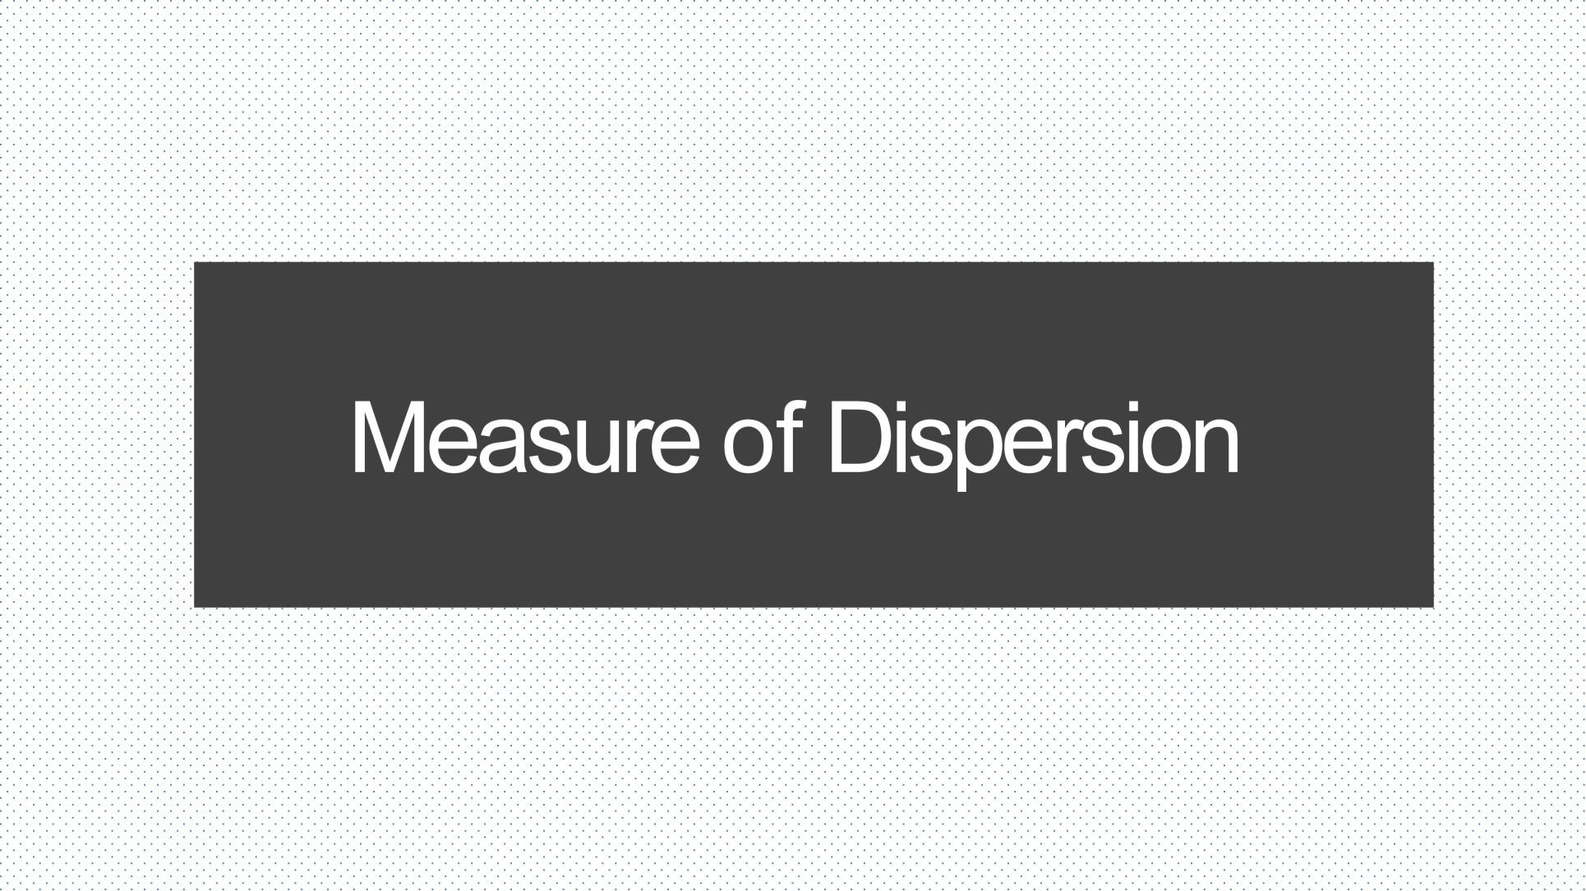

Slide 29
What’s the difference between central tendency and dispersion?
1. While central tendency tells you where most of your data points lie, dispersion summarizes how far apart your points from each other.
1. Data sets can have the same central tendency but different levels of dispersion or vice versa. Together, they give you a complete picture of your data

Slide 30
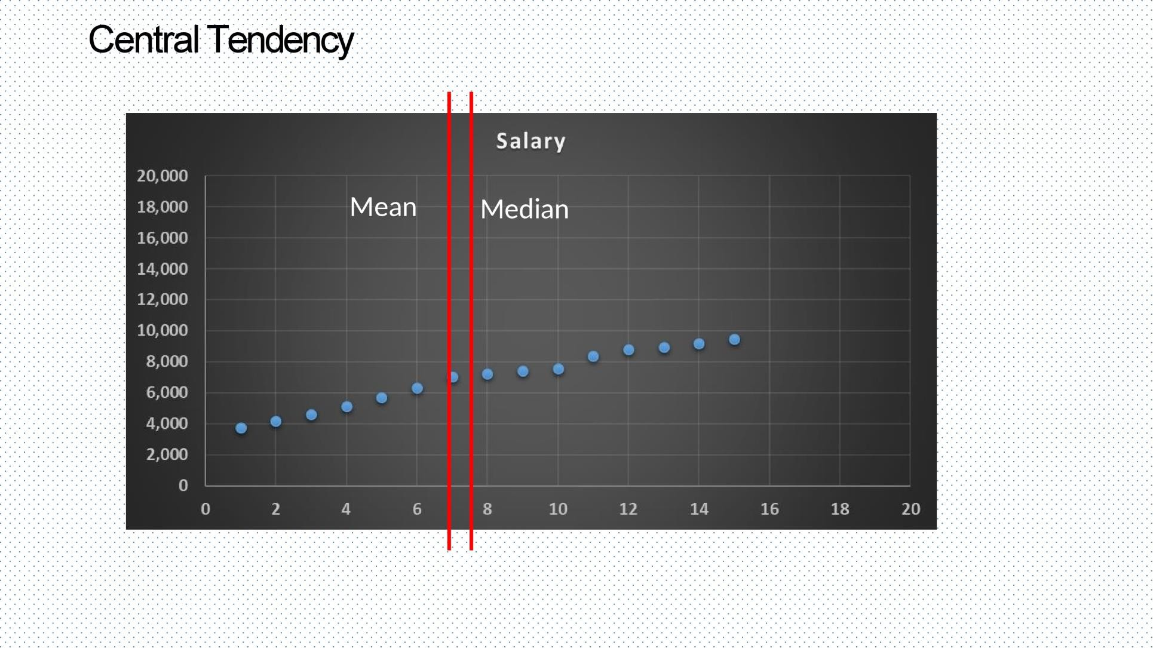

Slide 31
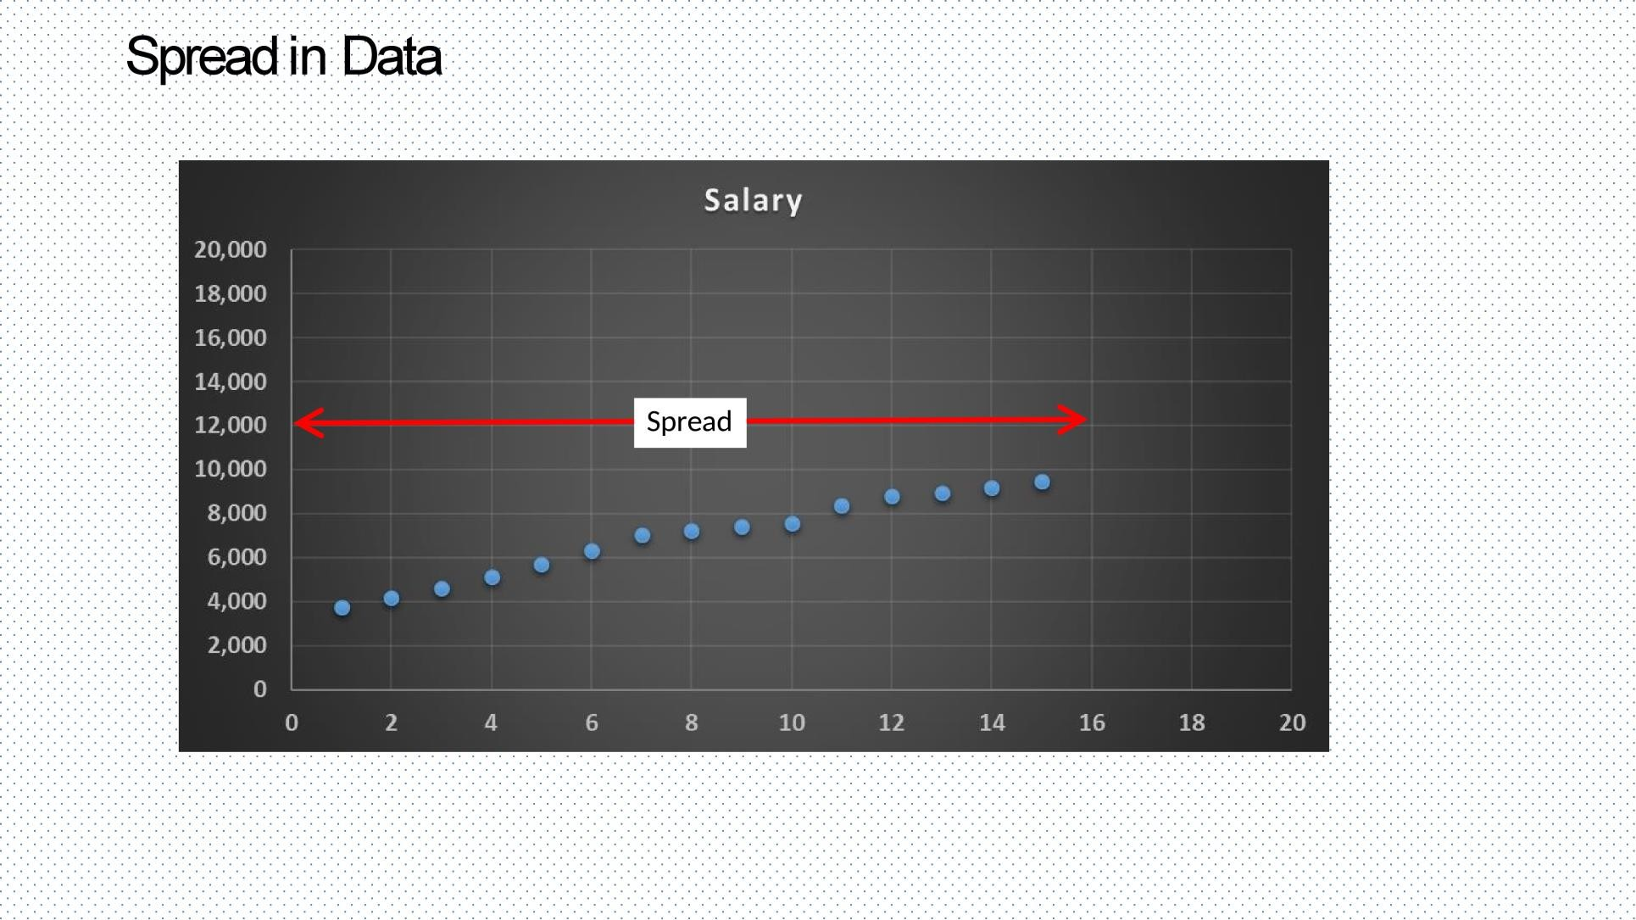

Slide 32
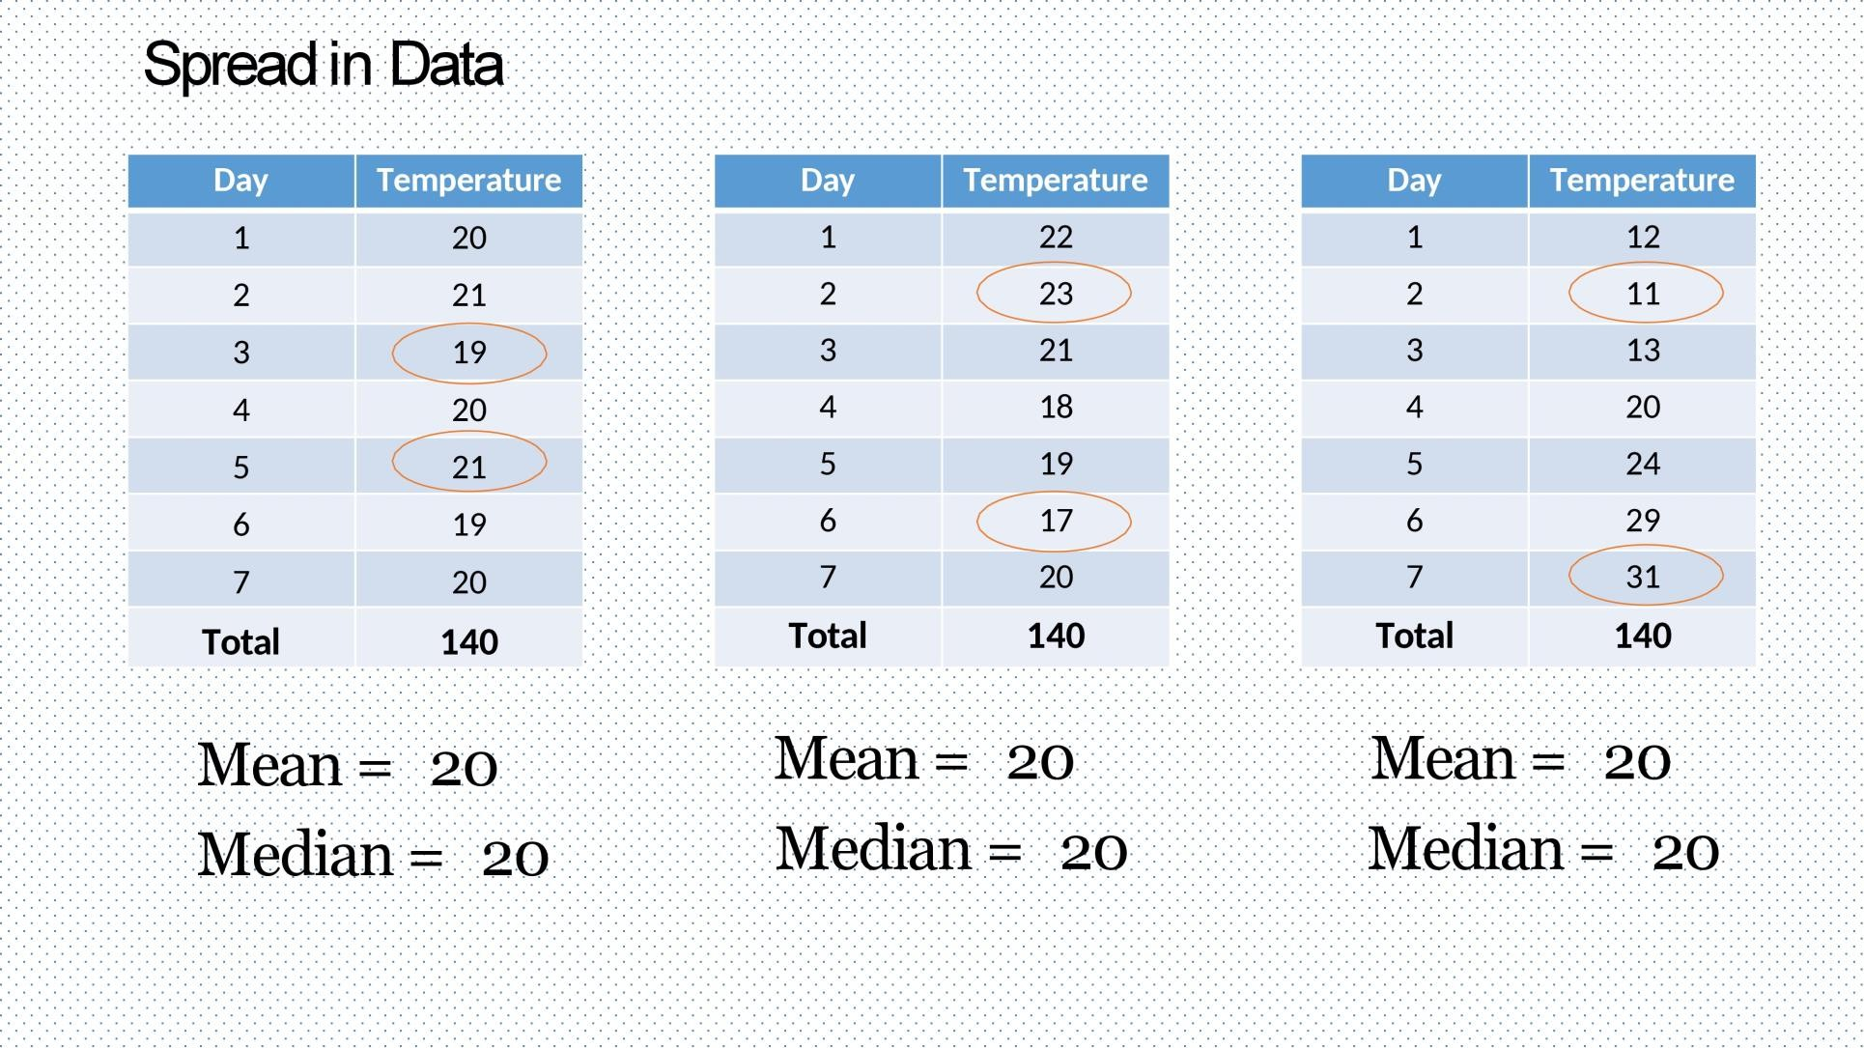
This example show how central tendency alone is not enough to describe data here we have same mean and median but each time with different data so we need to measure dispersion

Slide 33
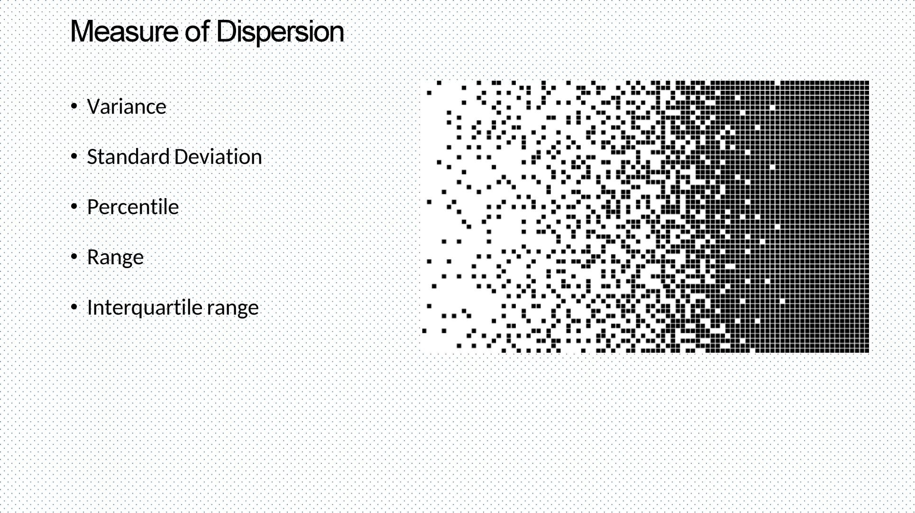

Slide 34
Variance:
variance measures how far each number in the set is from the mean
Variance is often depicted by this symbol: σ².
How to calculate variance step by step:
Calculate the mean x̄.
Subtract the mean from each observation. X- x̄
Square each of the resulting observations. (X- x̄) ^2
Add these squared results together.
Divide this total by the number of observations n (in case of population) to get variance S2.

Slide 35
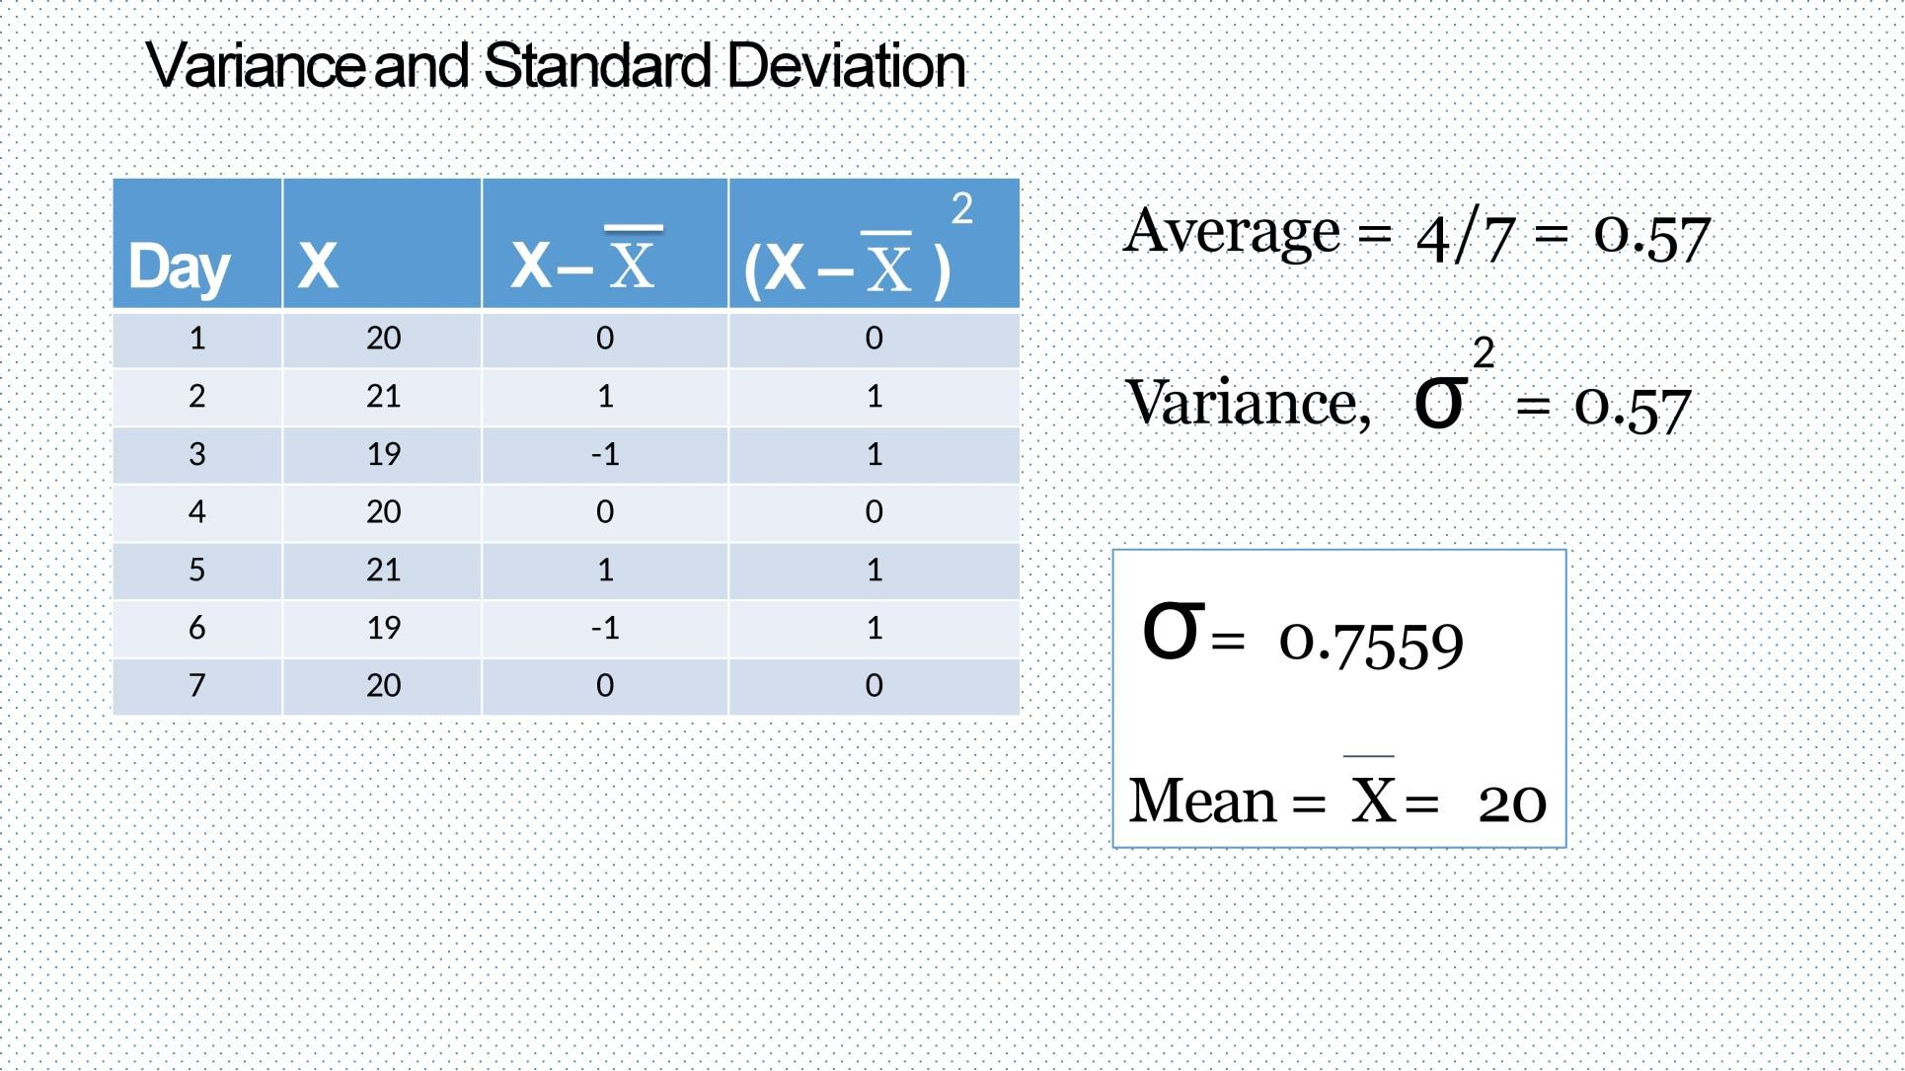

Slide 36
Standard Deviation :
represents the average spread distance of an observation from the mean
Its symbol is σ (the greek letter sigma)
It is the square root of the Variance.
How to calculate standard deviation step by step:
Calculate the mean x̄.
Subtract the mean from each observation. X- x̄
Square each of the resulting observations. (X- x̄) ^2
Add these squared results together.
Divide this total by the number of observations n to get variance S2.
Use the positive square root to get standard deviation S

Slide 37
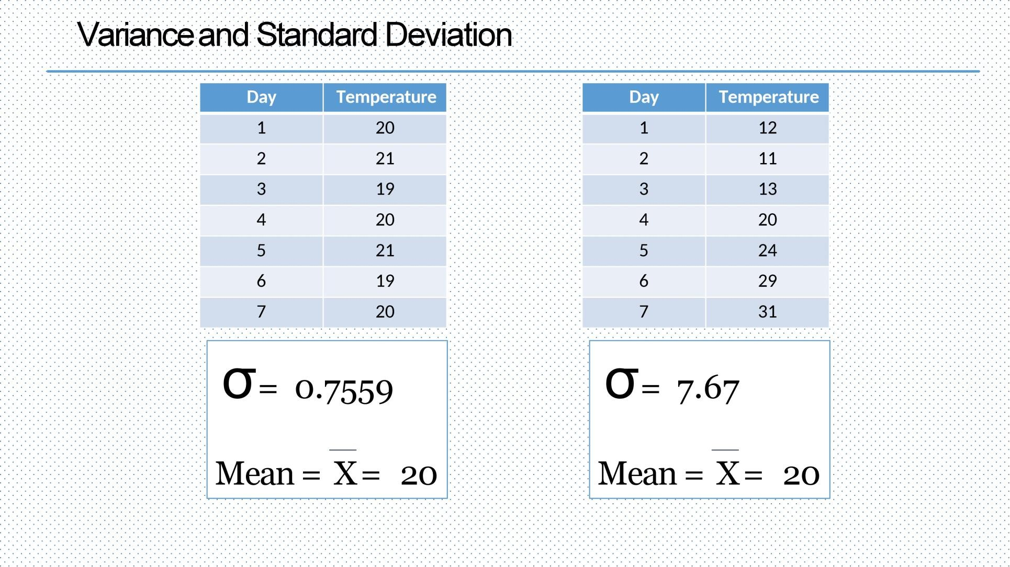

Slide 38
Variance and StandardDeviation
The mean of two samples of the sizes 250 and 320 were found to be 20,12 respectively. Their standard deviations were 2 & 5, respectively. Find the variance of combined sample of size 650.
10.23
32.5
65
26.17

Slide 39
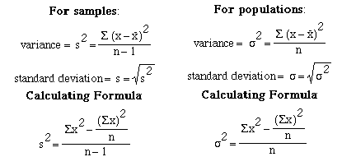
Population vs. Sample
The primary task of inferential statistics is making an opinion about something by using only an incomplete sample of data.
A population is defined as all members (e.g. occurrences, prices, annual returns) of a
specified group. Population is the whole group.
A sample is a part of a population that is used to describe the characteristics (e.g. mean or standard deviation) of the whole population.

Slide 40
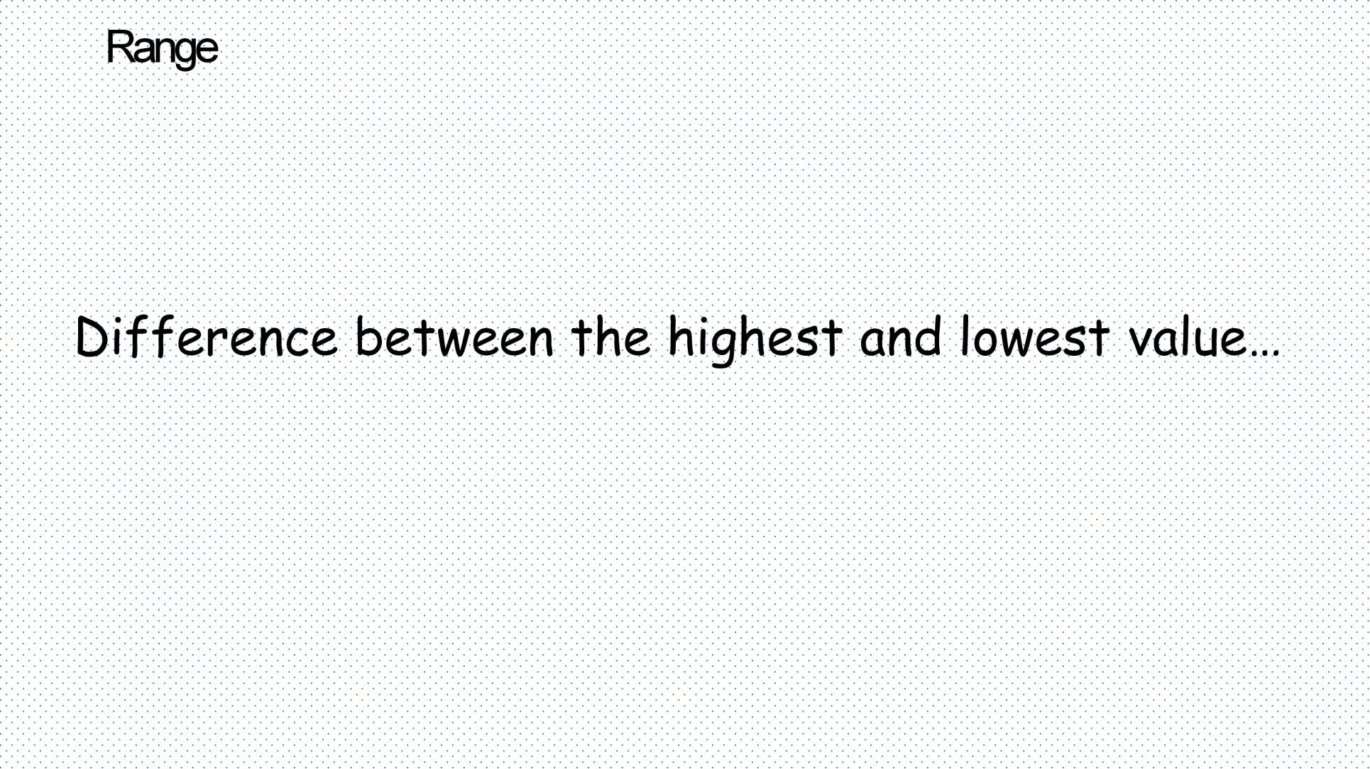

Slide 41
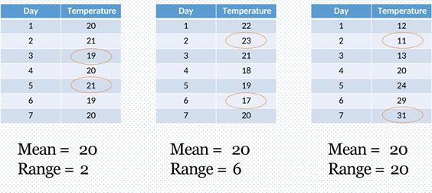
Range:
The most simple measure of variability , It is the difference between the highest and the
lowest value (ex1:19-21=2, ex2:23-17=6,ex3:31-11=20)
Let’s take the below example: the three samples of data have the same mean if you adequately describe a distribution some time it may need more information than the measures of central tendency

Slide 42
Range:
1. Calculate the range of the given sets of data 7,47,8,42,47,95,42,96,2
θ 6
9θ 9£
:θ 7ỳ Aθ %£

Slide 43
interquartile range :
It is a better measure of dispersion than range because it leaves out the extreme values.
It equally divides the distribution into four equal parts called quartiles:
First 25% is 1st quartile (Q1)
middle one is 2nd quartile (Q2)
last one is 3rd quartile (Q3)
2nd quartile (Q2) divides the distribution into two equal parts of 50%. So, it is same as Median.
The interquartile range is the distance between the third and the first quartile, or, in other words, IQR = Q3- Q1

Slide 44
How to calculate IQR:
Step 1: Order from low to high
Step 2: Find the median or in other words Q2
Step 3: Then find Q1 by looking the median of the left side of Q2
Steps 4: Similarly find Q3 by looking the median of the right of Q2
Steps 5: Now subtract Q1 from Q3 to get IQR

Slide 45
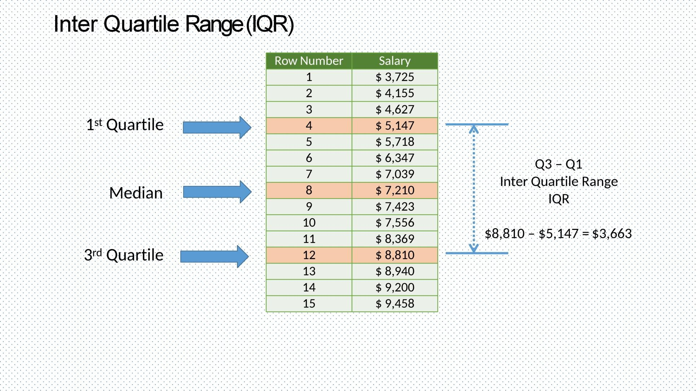

Slide 46
How to calculate IQR:
Calculate the interquartile range of the following data 17, 18, 18, 19, 20, 21, 21, 23, 25
θ ¯
9θ e
:θ £
Aθ %
Find the interquartile range using the following.
Minimum: 1,Q1: 3,Median: 5,Q3: 7,Maximum: 9
θ ¯
9θ £
:θ %
Aθ ỳ'

Slide 47
Advantage of IQR:
The main advantage of the IQR is that it is not affected by outliers because it doesn’t take
into account observations below Q1 or above Q3
observations can be outliers when they lie more than 1.5 IQR below the first quartile or
1.5 IQR above the third quartile.
3. Outliers = Q1 – 1.5* IQR (or) Q3 + 1.5*IQR

Slide 48
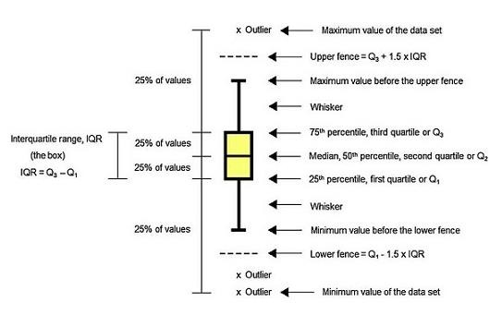
Box Plot:
mainly used when you are describing center and variability of your data.
It is also useful for detecting outliers in the data.
Used to visualize IQR

Slide 49
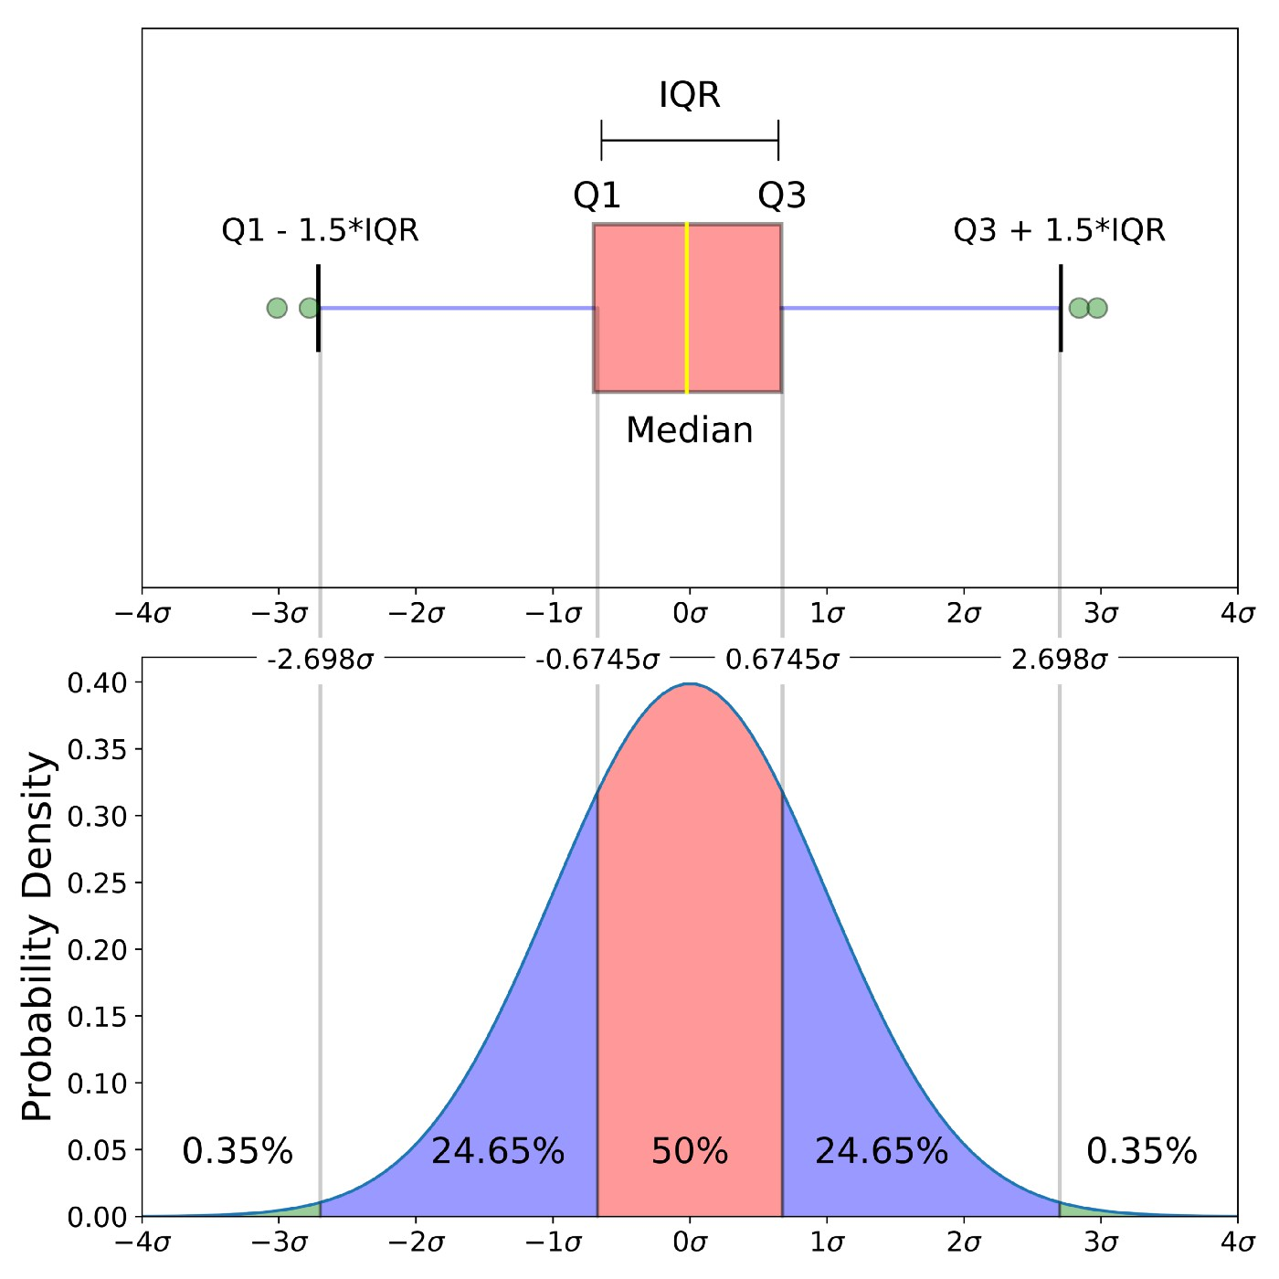
IQR is plotted in a boxplot and probabiltiy density

Slide 50
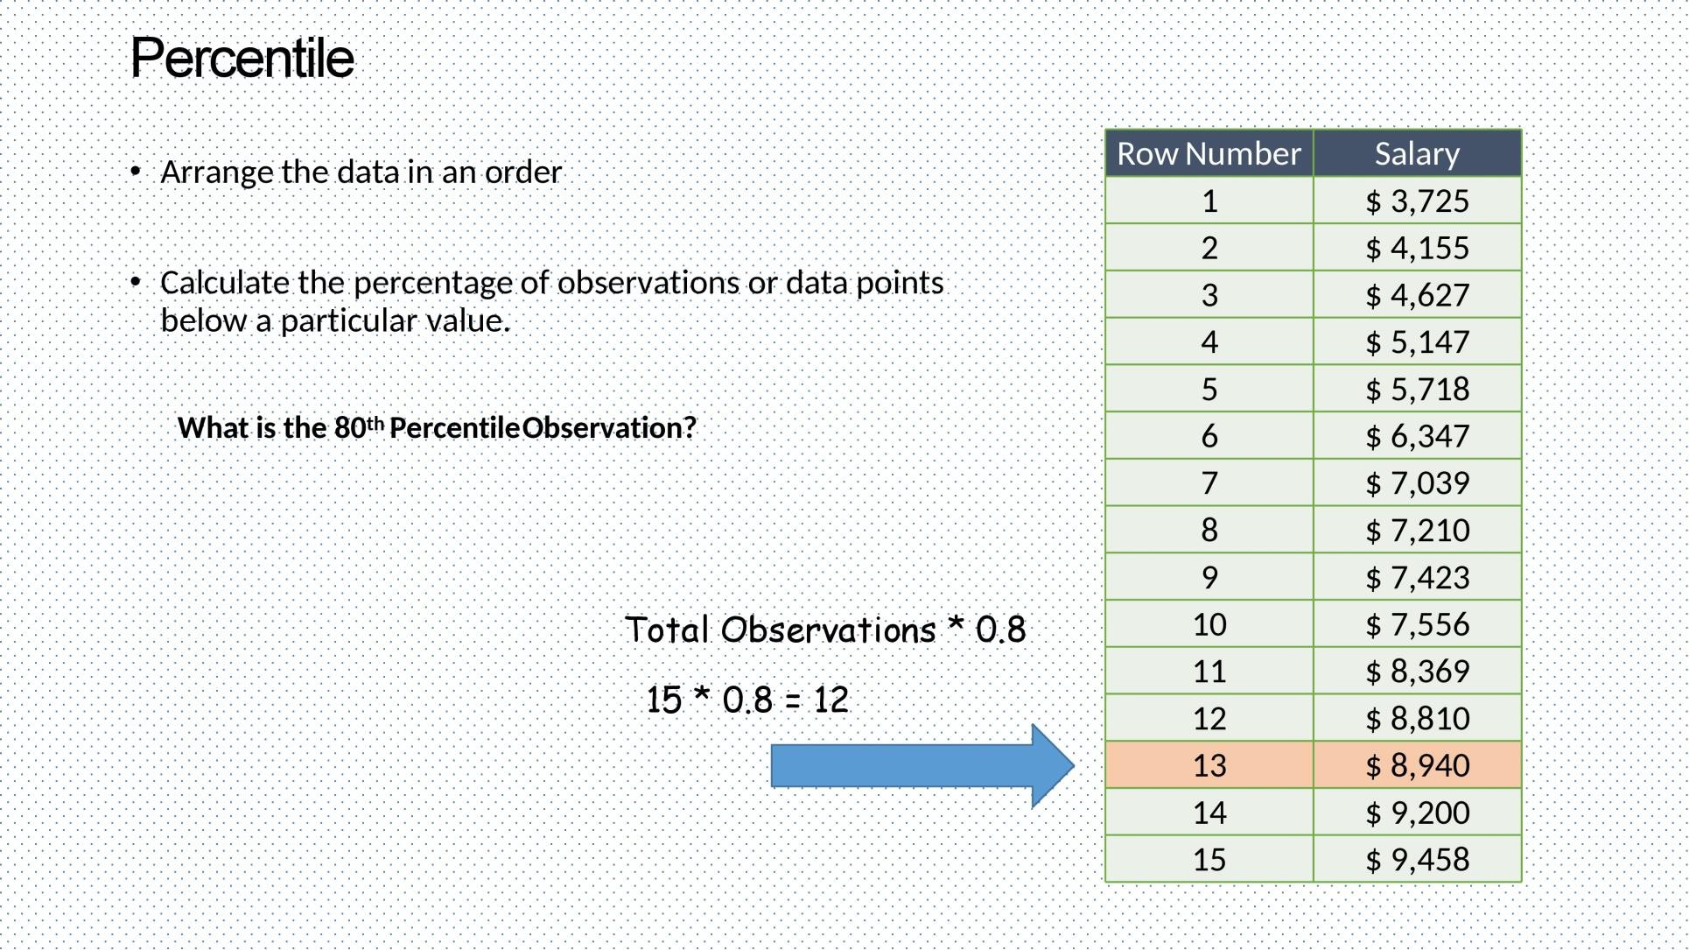

Slide 51
Percentile:
the number that expresses the value that a given percent of the values are lower than
Example:We have an array of the ages of all the people that working in same office ages = [25,31,43,48,50,41,39,60,52,32,27,46,47,55]
What is 75. percentile? The answer is 48, meaning that 75% of the people are 48 or
younger. Steps:
Arrange in ascending order [25,27,31,32,39,41,43,46,47,48,50,52,55,60]
Find the Rank = Percentile/100 * (number of things )
Rank= 0.75*14=10.5 take the round 11 then subtract 1 for zero index so rank=10 with value 48

Slide 52
Percentile:
1. Scores on a certain standardized test have a mean of 500, and a standard deviation of
100. What score would you need to fall at the 84th percentile?600
θ %£
B. 400
:θ eỲỲ
D. 600

Slide 53
Skewness
Skewness is the measure of how much the probability distribution of a random variable deviates from the normal distribution.
There are two types of skewness:
Positive / Right Skewness
Negative / Left Skewness

Slide 54
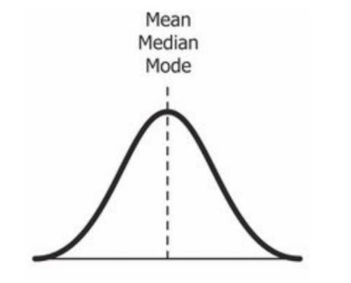
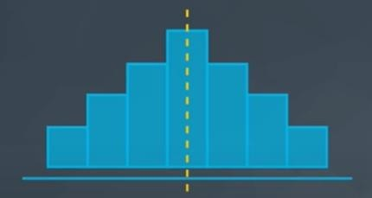
Symmetric/Normal Distribution
The value of skewness for a normal
distribution is zero.
mode = median = mean

Slide 55
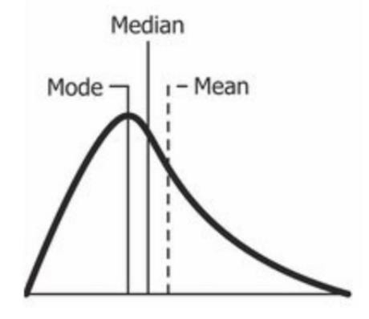
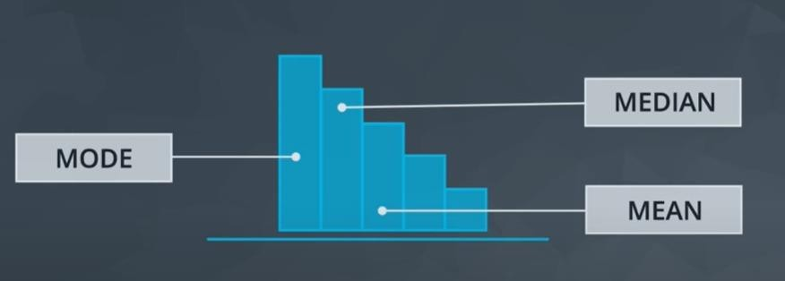
Right Skewed Distribution
The value of skewness for a right skewed distribution is less than zero.
mode < median < mean

Slide 56
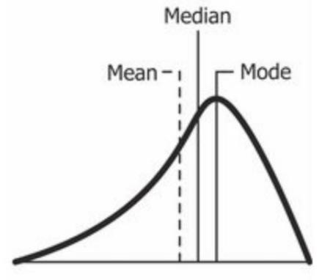
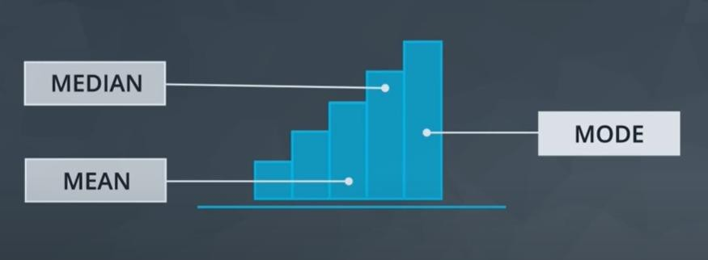
Left Skewed Distribution
The value of skewness for a left skewed distribution is less than zero.
mean < median < mode

Slide 57
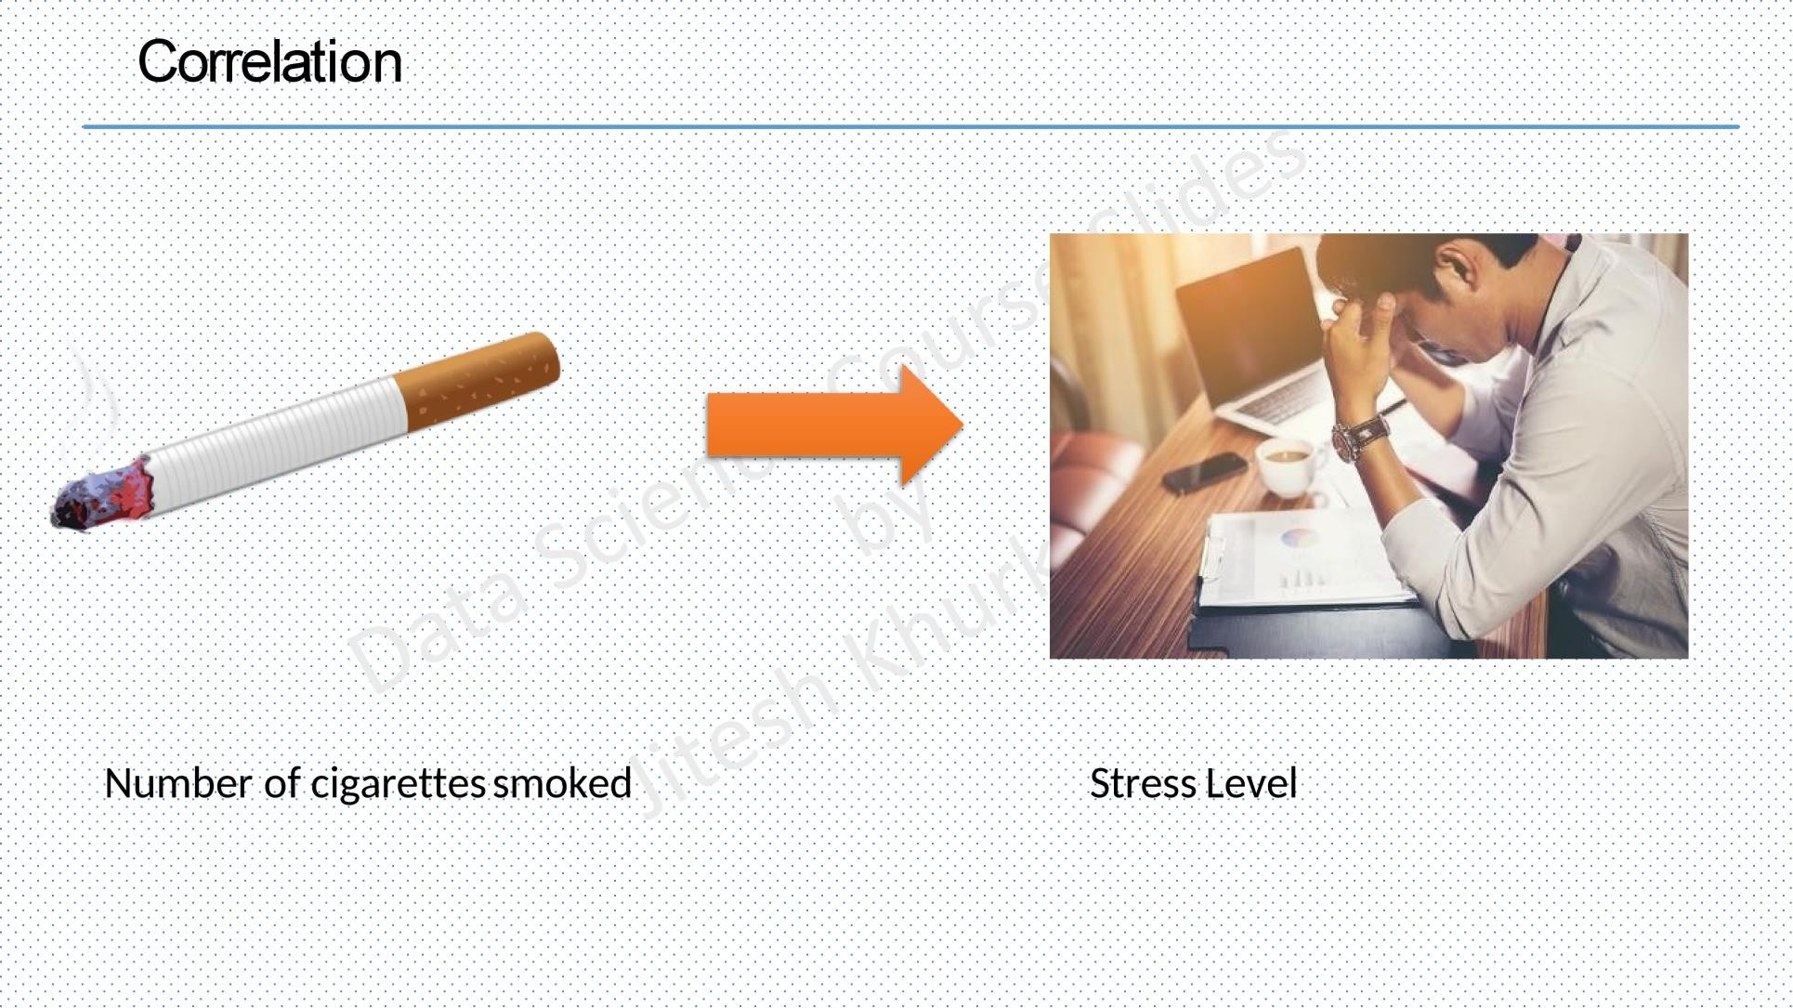

Slide 58
Correlation :
used to find the relationship between two variables which is important in real because we can predict value of one variable.
Example from our daily life:
The more time you spend running on a treadmill, the more calories you will burn.
The more money you save, the more financially secure you feel.
The more cigarettes you smoked, the higher stress level you have
Use Scatter plot in visualization of correlation

Slide 59
The Correlation Coefficient:
The correlation coefficient (r)/pearson r indicates a measure of the strength of a relationship between two variables.
Possible correlations range from +1 to –1.
Direction of correlation :
A correlation of –1 indicates a perfect negative correlation, meaning that as one variable goes up, the other goes down.
A correlation of +1 indicates a perfect positive correlation , meaning that as one variable goes up, the other goes up together.
A correlation of zero indicates that there is no relationship between the
variables.
Describe linear relations only

Slide 60
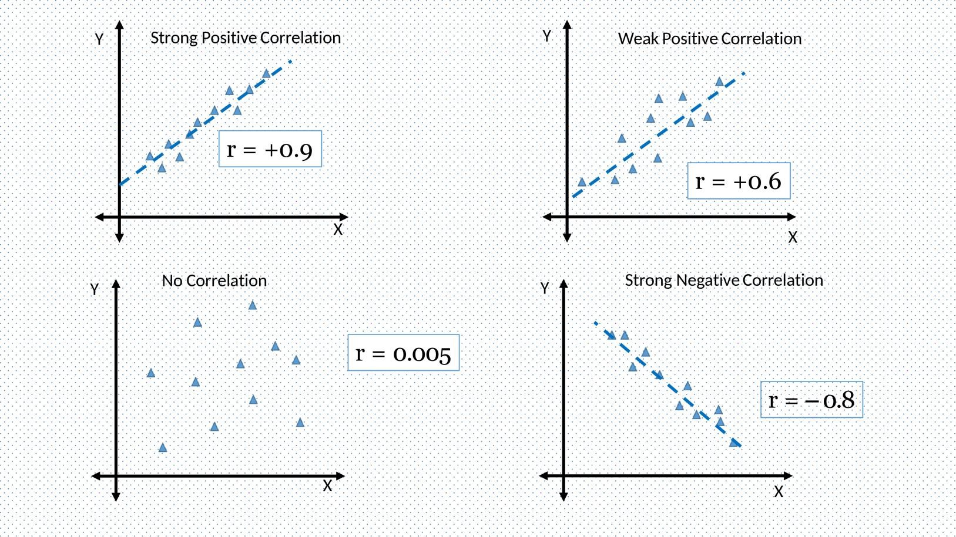
Scatter plot in visualization of correlation , The horizontal axis represents one variable,
and the vertical axis represents the other
Regression line : is the line separate the 2 classes
As points surrounded regression line the strength of correlation increase

Slide 61
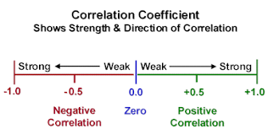
The closer the correlation is to 0, the weaker it is, while the closer it is to +/-1, the
stronger it is.

Slide 62
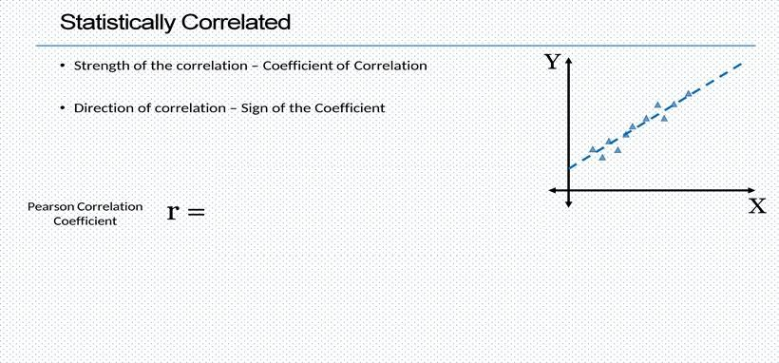
σ 𝑥 − 𝑥ҧ_{− 𝑌−𝑌}ത
𝑁 − 𝜎_{𝑦} + 𝜎_{𝑥}

Slide 63
The Correlation Coefficient:
X:values of the x-variable in a sample
xˉ:mean of the values of the x-variable
y:values of the y-variable in a sample
yˉ:mean of the values of the y-variable
N : no, of records
σ : standard deviation

Slide 64
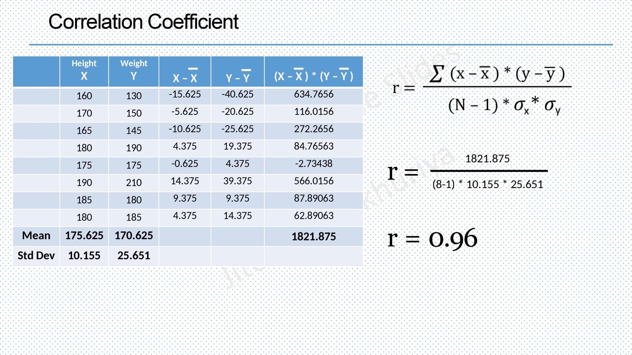

Slide 65
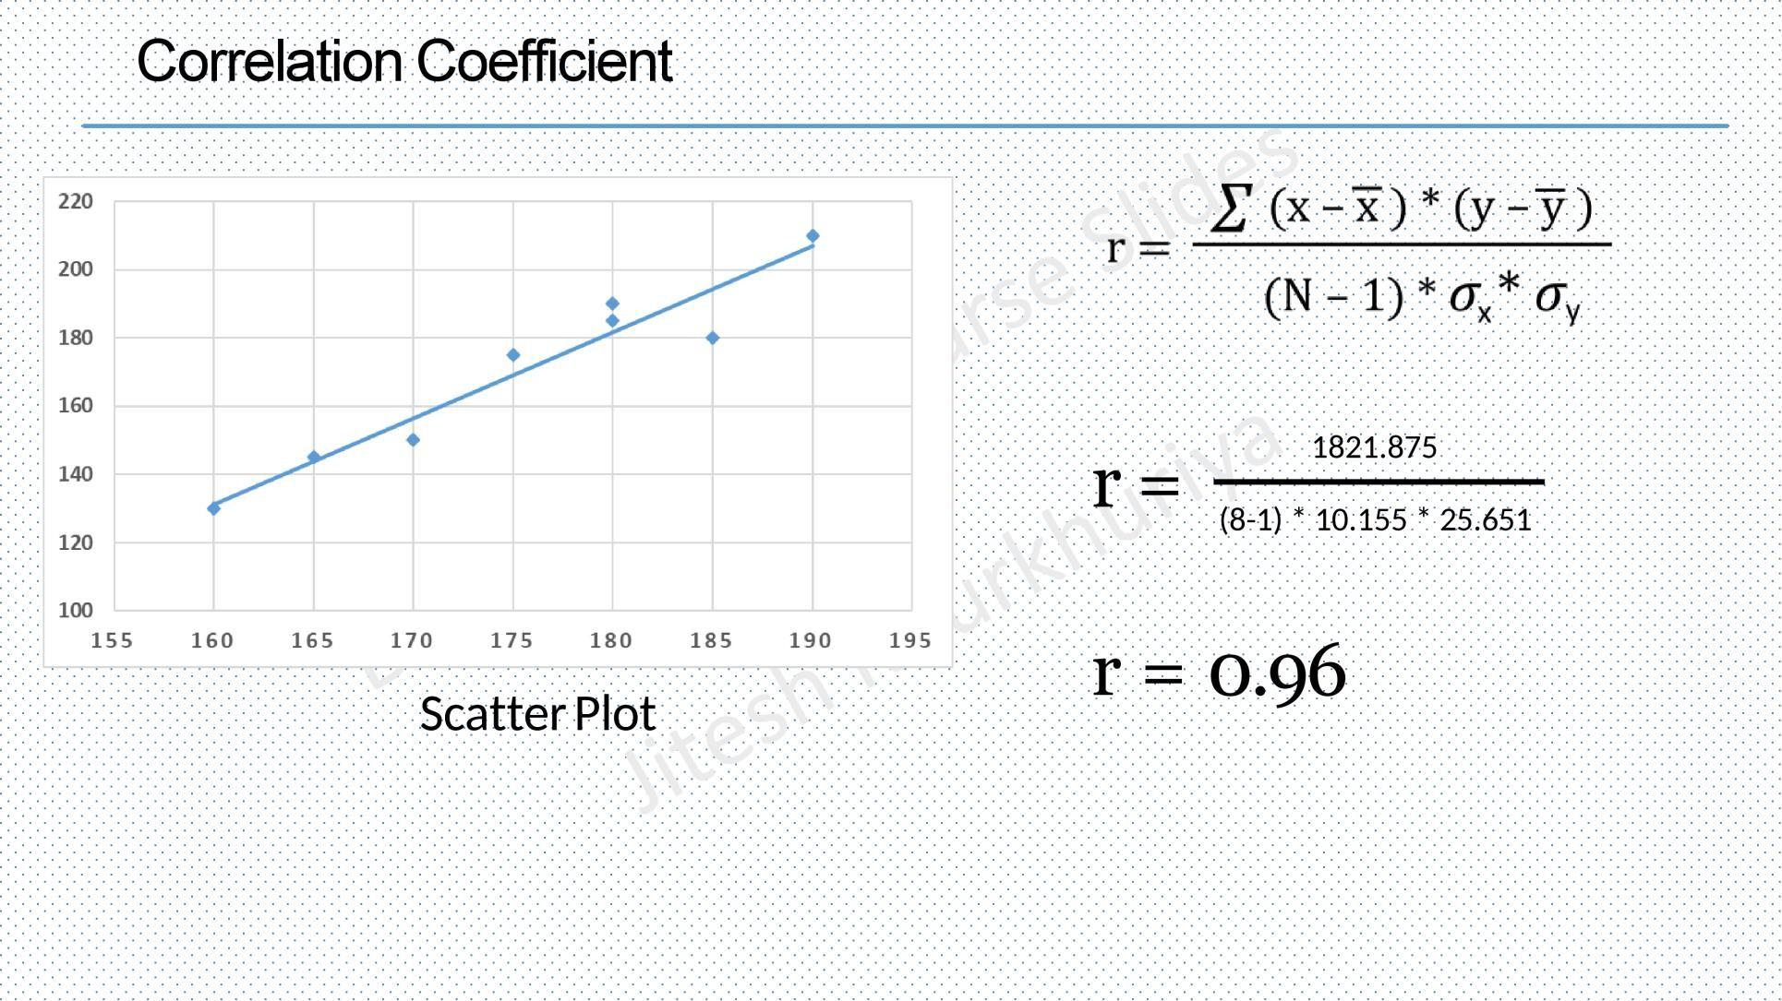

Slide 66

Questions ?!

Slide 67
Thanks!

